Slide 1
Geography Lesson
A Class Project

Slide 2
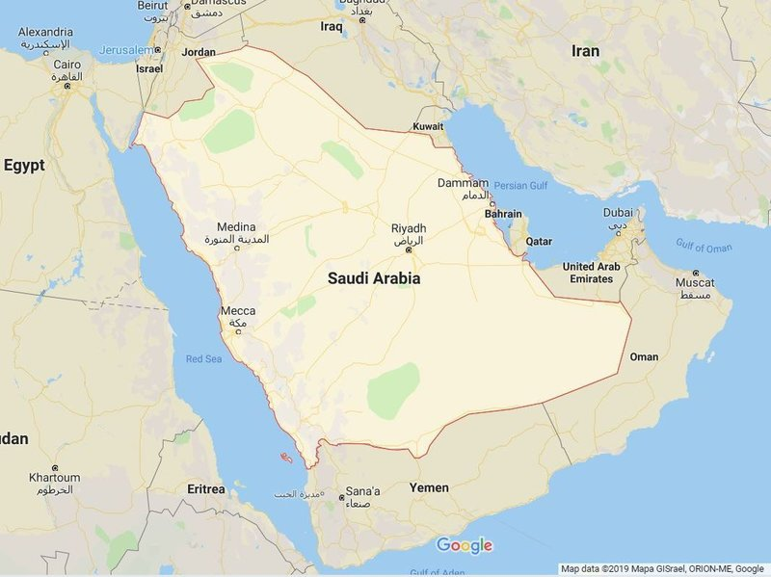
Saudi Arabia
Population: 32.9 Million
Capital: Riyadh
Fun Fact: Has the Largest Sand Desert on Earth

Slide 3
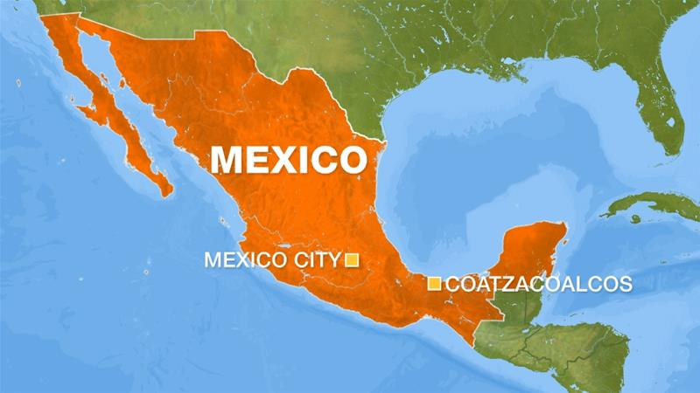
Mexico
Population: 127 Million
Capital: Mexico City
Fun Fact: Over 50% of the population is under 18 years old

Slide 4
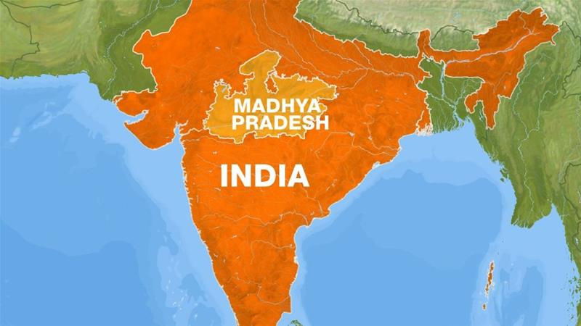
India
Population: 1.2+ Billion
Capital: New Delhi
Fun Fact: The only country with a Bill of Rights for cows

Slide 5
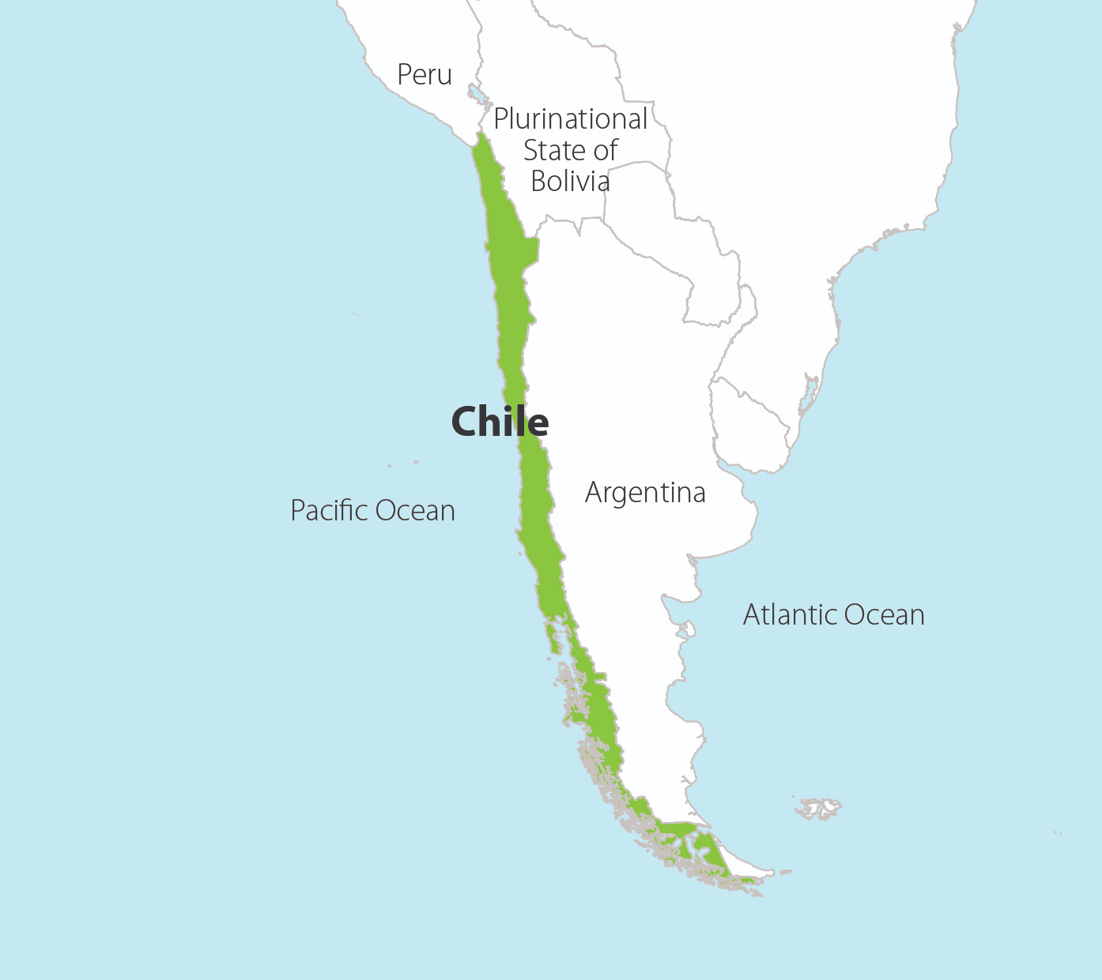
Chile
Population: 18 Million
Capital: Santiago
Fun Fact: Known by its inhabitants as "Country of Poets"

Slide 6
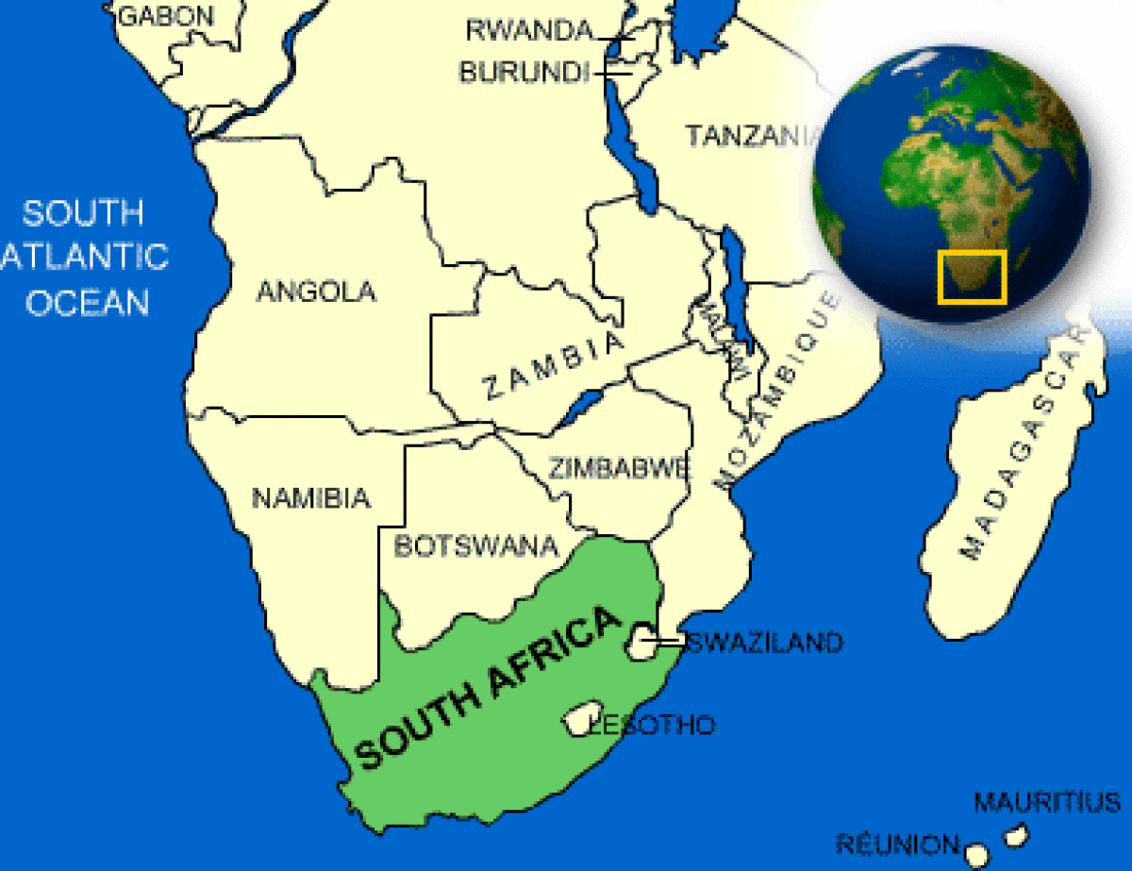
South Africa
Population: 58 million
Capital: Johannesburg
Fun Fact: The world's first successful heart transplant was performed in Cape Town, SA

Slide 7
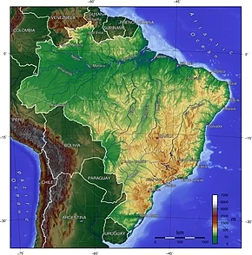
Brazil
Population: 209 million
Capital: Brasilia
Fun Fact: Has won the World Cup 5 times!

Slide 8
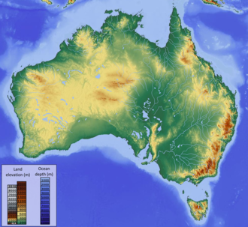
Australia
Population: 25.5 Million
Capital: Sydney
Fun Fact: The Great Barrier Reef off the coast of Australia is the largest ecosystem in the world.

